Slide 1
Efficient and Consistent Flow Update for Software Defined Networks
Archana M
Class no:14 S7 BTech CSE
Dept of CSE MACE Kothamangalam
September 05 , 2018

Slide 2
CONTENTS
Efficient and Consistent Flow Update for Software Defined Networks
Introduction
Existing method
SDN Architecture
Consistent update
Proposed scheme
Algorithm
Analysis of time complexity
Evaluation
Conclusion

Slide 3
INTRODUCTION
Efficient and Consistent Flow Update for Software Defined Networks
Flow update problem: set of flows are rearranged.
Two main challenges
Efficiency
Consistency
Proposes a scheme that works in four phases.
Faster than existing schemes.

Slide 4
INTRODUCTION(contd…)
Efficient and Consistent Flow Update for Software Defined Networks
SDN separates control and data plane.
Widely used in load balancing and link failure recovery.
Design a dynamic algorithm for flow update in SDN.

Slide 5
EXISTING METHOD
Efficient and Consistent Flow Update for Software Defined Networks
Update speed is not fast.
Incurs congestion in some cases.
Inefficient in handling deadlocks.
High operational cost.

Slide 6
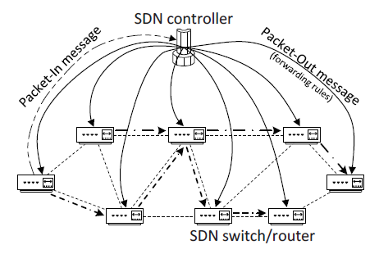
SDN ARCHITECTURE
Efficient and Consistent Flow Update for Software Defined Networks
Courtesy:https://ieeexplore.ieee.org/document/8314694

Slide 7
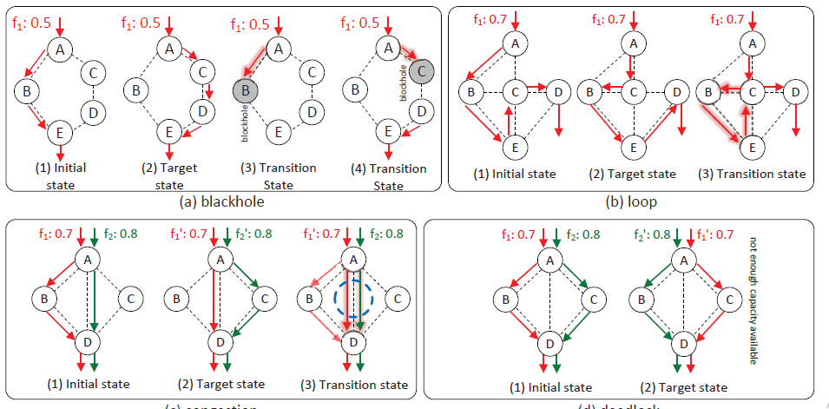
CONSISTENT UPDATE PROBLEMS
Efficient and Consistent Flow Update for Software Defined Networks
Black hole ,loop ,congestion , deadlock problems.
Courtesy:https://ieeexplore.ieee.org/document/8314694

Slide 8
ALGORITHM
Efficient and Consistent Flow Update for Software Defined Networks
Step 1:partition flow into segments.
Step 2:generate dependency graph.
Step 3:generate non-deadlock rounds.
Step 4:resolve deadlock.

Slide 9
PROPOSED SCHEME
Efficient and Consistent Flow Update for Software Defined Networks
ParFlow():partition flow pairs to segment pairs.
GenDepGraph():generate dependancy graph.
GenRnd():sequence of non-deadlock rounds.
RsvDead():resolve one deadlock.

Slide 10
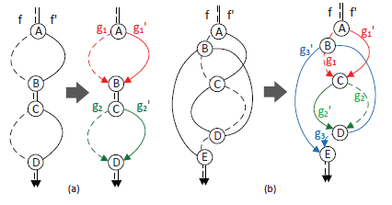
SEGMENTING FLOW PAIRS
Efficient and Consistent Flow Update for Software Defined Networks
To increase update parallelism.
Partition flow pair (f , f’) into segment pairs.
Partition pairs having same start and end points.
Courtesy:https://ieeexplore.ieee.org/document/8314694

Slide 11
DEPENDENCY GRAPH
Efficient and Consistent Flow Update for Software Defined Networks
l->(g , g’): availability of bandwidth on link l.
(g , g’)->l:release bandwidth to link l.
Segment node.
Transmission bandwidth : TxBw.
Link node.
Available bandwidth : AvlBw.

Slide 12
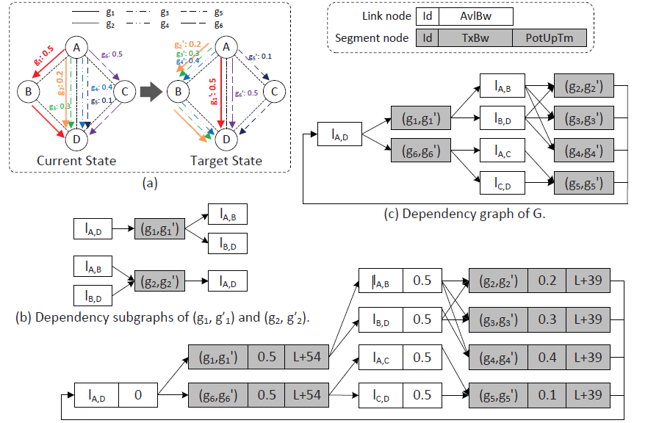
Efficient and Consistent Flow Update for Software Defined Networks
EXAMPLE
Courtesy:https://ieeexplore.ieee.org/document/8314694

Slide 13
NON-DEADLOCK ROUNDS
Efficient and Consistent Flow Update for Software Defined Networks
Step 1:initialize an empty round R.
Step 2:sort segment nodes by their TxBW.
Step 3:if there is enough bandwidth ,update (g , g’), add to R.
Step 4:if R is not empty ,update (g , g’) and release bandwidth.
Step 5:after update,(g , g’) is added in set R.

Slide 14
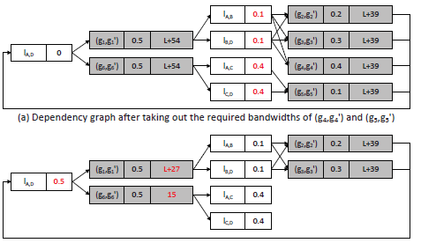
NON-DEADLOCK ROUNDS(Contd..)
Efficient and Consistent Flow Update for Software Defined Networks
Courtesy:https://ieeexplore.ieee.org/document/8314694

Slide 15
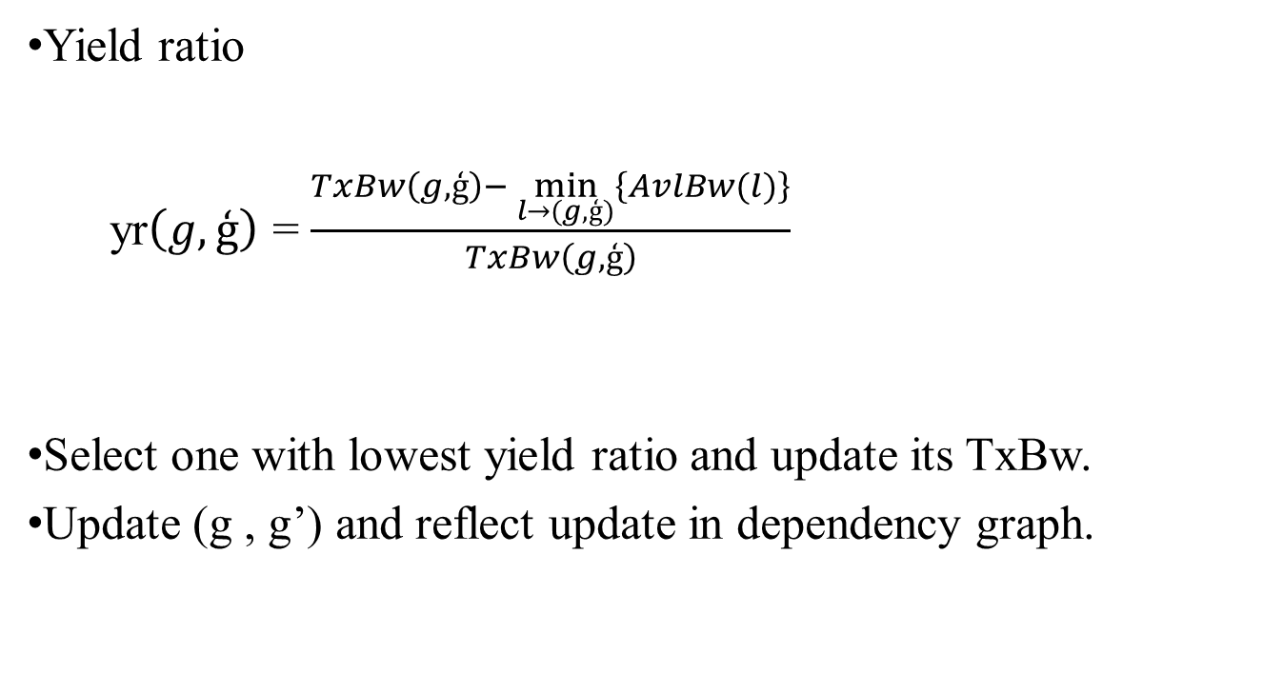
RESOLVING DEADLOCK
Efficient and Consistent Flow Update for Software Defined Networks
Yield ratio
yr$\left(g,ģ\right)$ = $\frac{TxBw\left(g,ģ\right)− \min_{l→(g,ģ)}\left\{AvlBw(l)\right\}}{TxBw\left(g,ģ\right)}$
Select one with lowest yield ratio and update its TxBw.
Update (g , g’) and reflect update in dependency graph.

Slide 16
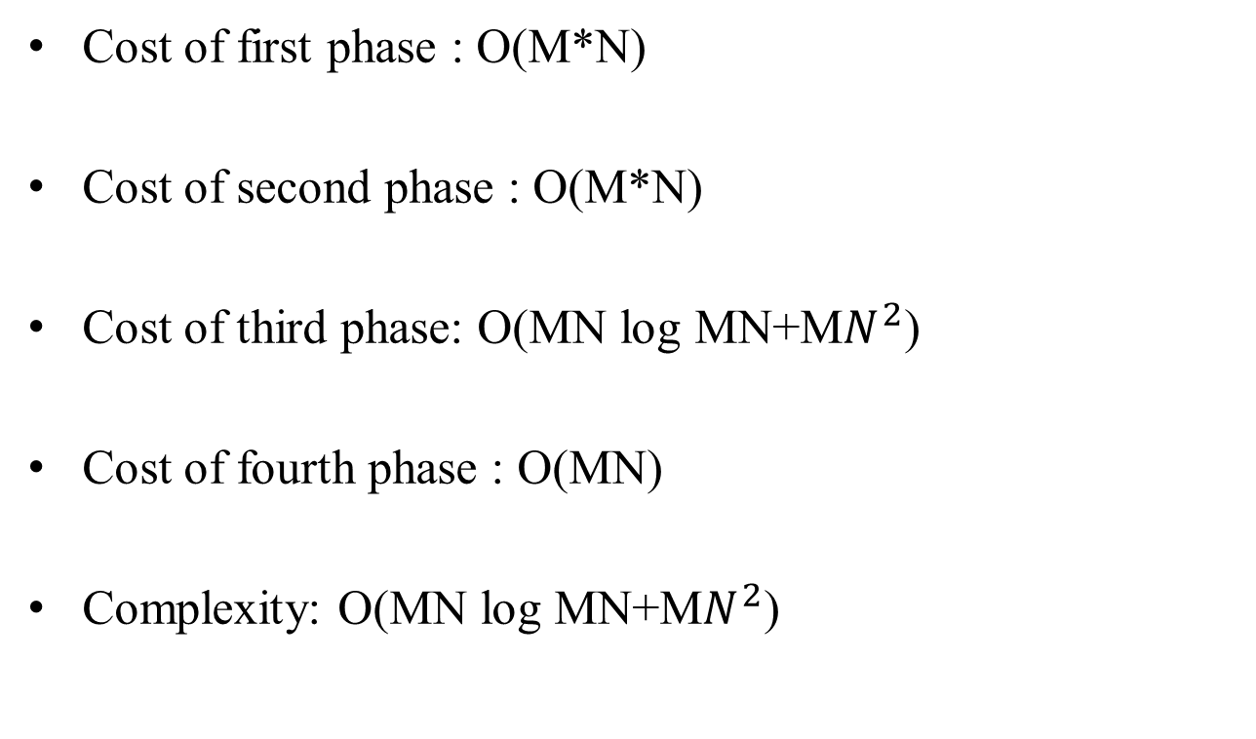
ANALYSIS OF COMPLEXITY
Efficient and Consistent Flow Update for Software Defined Networks
Cost of first phase : O(M*N)
Cost of second phase : O(M*N)
Cost of third phase: O(MN log MN+M$N^{2}$)
Cost of fourth phase : O(MN)
Complexity: O(MN log MN+M$N^{2}$)

Slide 17
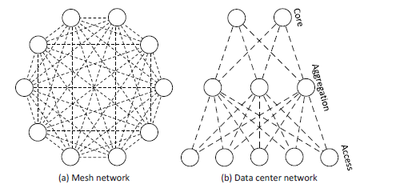
EVALUATION
Efficient and Consistent Flow Update for Software Defined Networks
Simulator : cupid scheme
Two types of network
Mesh network
Data center network
Courtesy:https://ieeexplore.ieee.org

Slide 18
EVALUATION(Contd...)
Efficient and Consistent Flow Update for Software Defined Networks
Evaluate against cupid scheme.
it considers only local dependency graph to perform update.
Does not check all link’s capacities for flow pairs.
Evaluate for light , medium and heavy network loads.

Slide 19
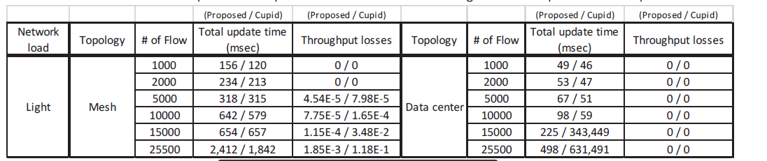
LIGHT NETWORK LOAD
Efficient and Consistent Flow Update for Software Defined Networks
Courtesy:https://ieeexplore.ieee.org

Slide 20
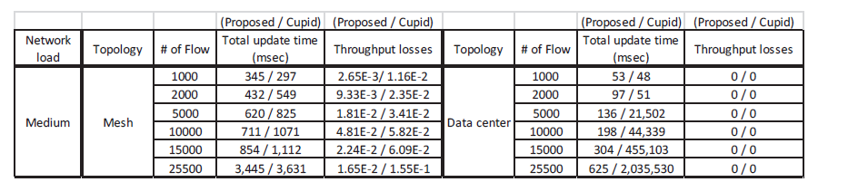
MEDIUM NETWORK LOAD
Efficient and Consistent Flow Update for Software Defined Networks
Courtesy:https://ieeexplore.ieee.org

Slide 21
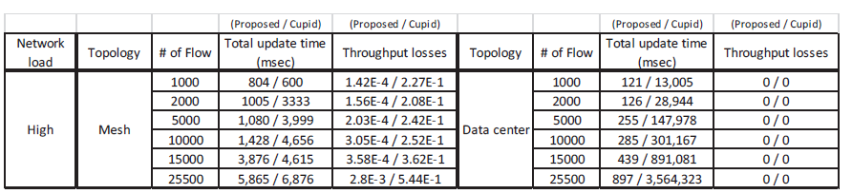
HEAVY NETWORK LOAD
Efficient and Consistent Flow Update for Software Defined Networks
Courtesy:https://ieeexplore.ieee.org

Slide 22
CONCLUSION
Efficient and Consistent Flow Update for Software Defined Networks
Efficiency and consistency of network was preserved.
SDN made the performance of network better.
SDN ensures freedom from congestion problems.
SDN performs better than cupid scheme.

Slide 23
REFERENCES
Efficient and Consistent Flow Update for Software Defined Networks
S. Jain, A. Kumar, S. Mandal, J. Ong, L. Poutievski, A. Singh,S. Venkata, J. Wanderer, J. Zhou, M. Zhu et al., ‘‘B4: Experience with a Globally-deployed Software Defined WAN,’’ in Proc. ACM SIGCOMM,vol. 43, no. 4, pp. 3--14, 2013.
S. Agarwal, M. Kodialam, and T. Lakshman, ‘‘Traffic Engineering in Software Defined Networks,’’ in Proc. IEEE INFOCOM, pp. 2211--2219, 2013.
K. Xi and H. J. Chao, ‘‘IP Fast Rerouting for Single-link/node Failure Recovery,’’ in Proc. Broadband Communications, Networks and Sys-tems, pp. 142--151, 2007.
H. Sufiev and Y. Haddad, ‘‘A Dynamic Load Balancing Architecture for SDN,’’ in Proc. IEEE Science of Electrical Engineering (ICSEE),pp. 1--3, 2016.
J. Liu, J. Li, G. Shou, Y. Hu, Z. Guo, and W. Dai, ‘‘SDN based LoadBalancing Mechanism for Elephant Flow in Data Center Networks,’’in Proc. IEEE Int’l Symposium on Wireless Personal MultimediaCommunications (WPMC), pp. 486--490, 2014.

Slide 24
REFERENCE(Contd..)
Efficient and Consistent Flow Update for Software Defined Networks
C. Cooper, R. Klasing, and T. Radzik, ‘‘Searching for Black-hole Faults in a Network Using Multiple Agents,’’ in Proc. Principles Of Distributed Systems, pp. 320--332, 2006.
M. Al-Fares, S. Radhakrishnan, B. Raghavan, N. Huang, and A. Vahdat,‘‘Hedera: Dynamic Flow Scheduling for Data Center Networks,’’ inProc. USENIX Conference on Networked Systems Design and Imple-mentation (NSDI), vol. 10, pp. 19--19, 2010 .
A. R. Curtis, J. C. Mogul, J. Tourrilhes, P. Yalagandula, P. Sharma,and S. Banerjee, ‘‘DevoFlow: Scaling Flow Management for High-performance Networks,’’ in Proc. ACM SIGCOMM, vol. 41, no. 4, pp.254--265, 2011.
W. Wang, W. He, J. Su, and Y. Chen, ‘‘Cupid: Congestion-freeConsistent Data Plane Update in Software Defined Networks,’’ in Proc.IEEE INFOCOM, pp. 1--9, 2016.
C.-Y. Hong, S. Kandula, R. Mahajan, M. Zhang, V. Gill, M. Nanduri, and R. Wattenhofer, ‘‘Achieving High Utilization with Software-driven WAN,’’ in Proc. ACM SIGCOMM, pp. 15--26, 2013.

Slide 25
Efficient and Consistent Flow Update for Software Defined Networks
THANK YOU

